Slide 1


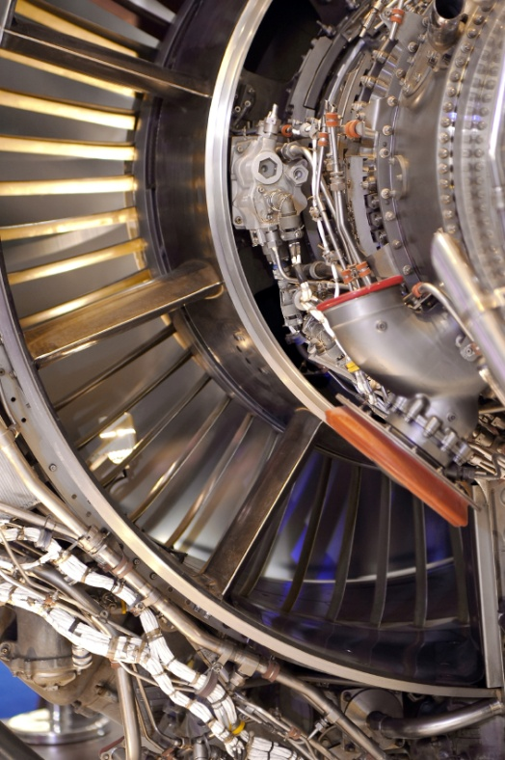

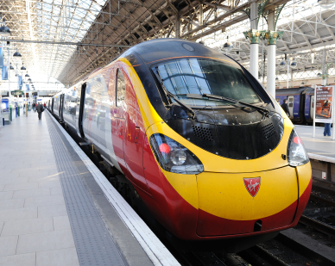
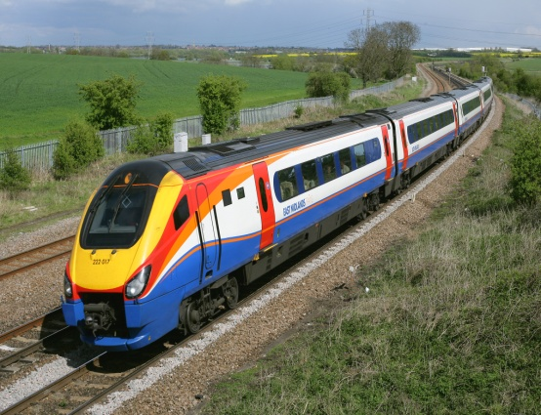
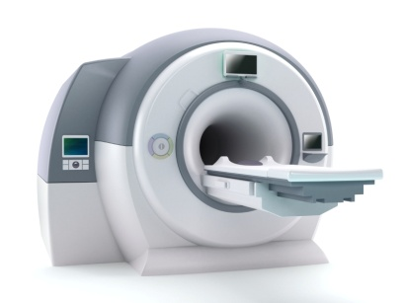

A Multi-sector National Centre
The EPSRC Centre for Innovative Manufacturing in
Through-life Engineering Services
Project 2: The Reduction of NFF Through System Design
Hosted by Cranfield University and Durham University
Paul Phillips, Project Manager

Slide 2
Content
Project overview
No Fault Found (NFF) research objectives
Understanding and quantifying the NFF problem (current investigations)
Through-life engineering studio capabilities in NFF research and testing

Slide 3
Current NFF Research in the EPSRC Centre for Through-Life Engineering Services
The EPSRC Centre for Through-life Engineering Services is undertaking a 3 year full-time research project to investigate the causes and solutions of NFF across all industries.
Initially concentrating on the aviation industry which appears to have the highest costs from this problem – and then subsequently with train systems and other partner industries.
The project is split into 3 interlinked phases
Phase 1: Organisational and Associated Causes of NFF (Month 0 -12)
Phase 2: Individual Systems Investigations (Month 6 – 36)
Phase 3: Multi-Disciplinary Modelling for Design Goals (Month 12 – 36)
Notes:
It’s a full 3 year project across all industries – anyone who has a NFF problem – and many of them don’t know they have a problem!
We’ll concentrate on aviation first that has the best knowledge and procedures and then move to trains. But we are keen to expand to any industry that may have a problem, cars, trucks, wind turbines etc.
However MOD, due to the way it’s organised, needing high periods of intensive operations and also long periods of peacetime or training?
Traditionally have had lots the people but no longer and also the pressure from support organisations who now provide much of the support who are cost focussed.

Slide 4
Phase 1: Organisational and Associated Causes of NFF
Objectives
Investigate NFF in a selection of RAF aircraft and compare with civilian operators (e.g. Flybe)
Investigate NFF occurrences in a selection of different rolling stock and rail systems – Bombardier Transport
Identify options for procedural, organisational and Through-Life Engineering Service Change
Identify types of NFF and root causes
Investigate the effect that NFF has on support and supply chains.

Slide 5
Why the need to identify/understand the NFF Problem
£
Eliminate NFF/
reduce its consequences
NFF
problems
Increased
stakeholder
satisfaction
We need to identify the
root causes/problem origin
Notes:
So to re-emphasise, we need to identify the root causes and the original problem origin (diagnostic success) if we are to provide an increase in satisfaction and a saving of money!

Slide 6
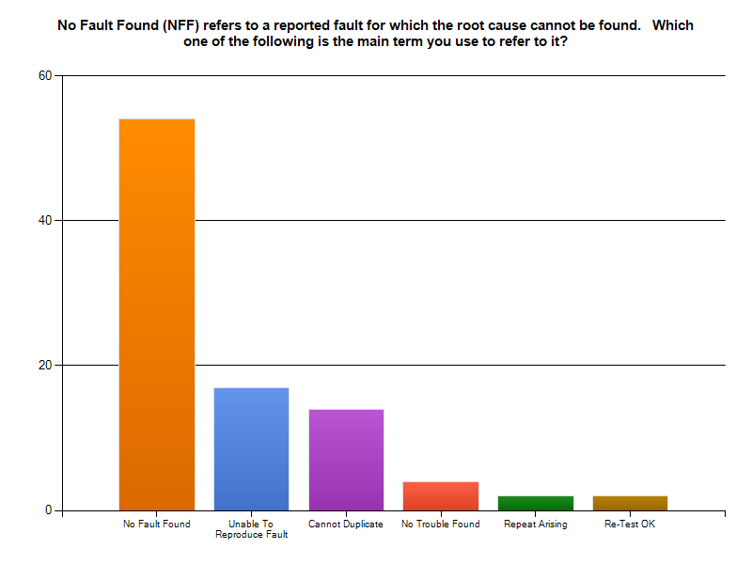
Understanding No-Fault Found
A recent survey carried out by Copernicus Technologies LTD show there is a clear lack of standardised terminology
Multiple terms used to describe different events related to the NFF problem
Different terms used to describe the same event, some of these terms are also used to describe NFF at only a specific maintenance level.
Does the most used term NO FAULT FOUND actually ensure a culture of acceptance of the problem?

Slide 7
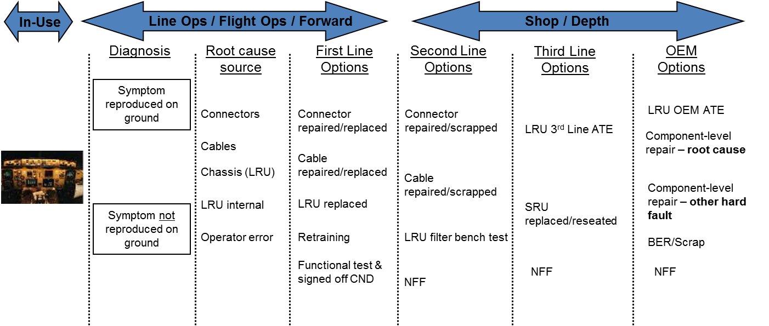
When does a Unit Under Test (UUT) become a NFF?
A NFF is not simply a single incident but a series of events beginning with a warning trigger which instigates a chain of maintenance activities, where at some point the cause of the maintenance can not be identified – NO FAULT FOUND!
Initial research show that there are differences in opinion on when a NFF becomes NFF!
Before tackling the NFF it is important we understand clearly where NFF occur in complex maintenance chain
Can we tackle the NFF problem when if this is unclear?
Can we work towards standardisation of NFF i.e. a NFF only occurs at 2nd line or below?
Is it even as straight forward as this?

Slide 8
NFF Root Causes?
An ‘event’ has caused that unit to end up in the maintenance workshop?
Intermittent, Integration fault
BIT/BITE warnings
False alarm
Wrong removal
This reason, the root cause of the NFF needs to be clearly understood and identifiable
What policies/procedures exist to deal with the NFF problem?
Can we transfer best practice and knowledge between industries?

Slide 9



Research into NFF in Industry
Flybe – Two main aircraft fleets with different rates of NFF and mitigation practices
Investigating what is being done differently between the two fleets
Looking at where in the supply chain NFF costs are -> Spare Parts Pool providers
Follow up visit to identify candidate electronic/mechanical units for further investigation
RAF – Visit to Air Command HQ in High Wycombe where it was revealed there is no standard operating policy across the RAF for dealing with NFF.
Is there a need for a NFF policy/standard across all the RAF
Do individual fleet project teams have ‘localised’ policies – developed through experience?
Visits are being arranged by High Wycombe to RAF Benson to investigate NFF on the Puma/Merlin Helicopters and RAF Conningsby for the Typhoon fleet
Bombardier Transport – A visit is being arranged to their maintenance depot to discuss policy/procedures
and to investigate a specific NFF problem they have with a door mechanism

Slide 10
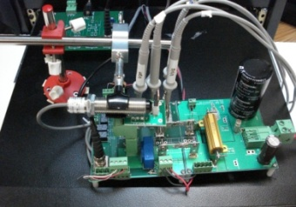
Phase 2: Individual System Investigations
Objectives
Establish candidate mechanical and avionic units for deeper investigation in the Centres Whole Systems Studio to identify the root cause of NFF.
Mechanical Engine Control Units
Digital Engine Control Units
Establish generic causes of NFF for candidate systems and component groups
Identify individual solutions
Establish generic design improvements/ solutions to solve in-service occurrence of NFF
Develop novel techniques to give Fault Detection and Isolation bounds based on systems research (PhD Research Project)
Notes:
The we will in phase 2 investigate individual systems

Slide 11
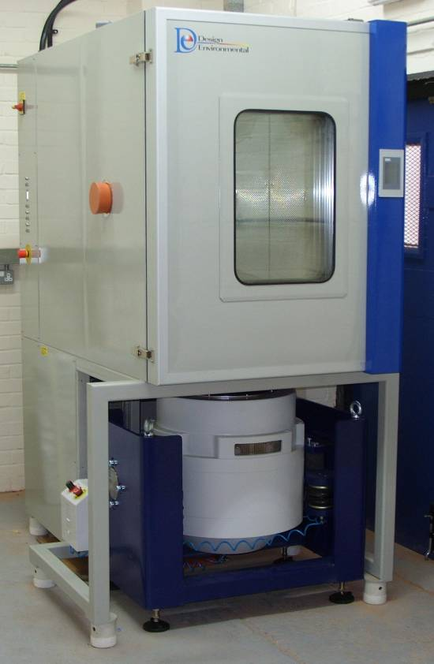
Environmental Chamber
Conditions include:
Temperature
Humidity
Vibration
Model ref: FS1100-70V
Internal size: 1100mm wide x 1000mm high x 1000mm deep
Temperature range: -70°C to +180°C
Temperature rate of change: 10°C/min average heating and cooling to IEC600068
Humidity Range: 10-98%RH

Slide 12
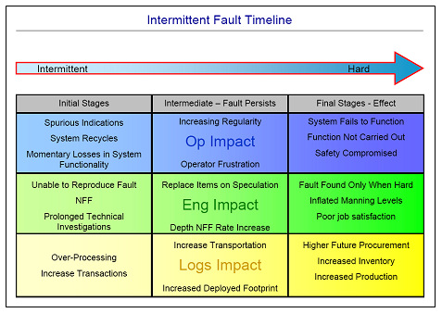
Testing for Intermittency as a Root Cause of NFF
Intermittent Faults in Electronic Systems
Solder Joints
Dry Joints
Debris
Wiring
Ground bonding
Solder creep/ageing
Internal harness chaffed
Electronic components
PCB
Electrical connectors
There are multiple root causes of NFF which will be investigated in the studio but:
All initial research and industry discussions indicate the No1 root cause of NFF begins with intermittency!
Intermittent faults are random, short in duration and extremely difficult to locate during maintenance tests resulting in the unit being labelled serviceable - NFF!!!
If left unrepaired an intermittent fault will progress from being a nuisance, to affecting system functionality until it becomes a hard fault increasing costs and safety risks.
The Centres studio will provide a strong and competitive research/testing capability to tackle intermittency problems in electronics

Slide 13
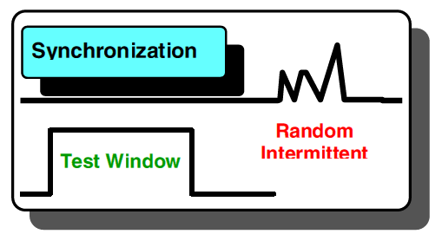
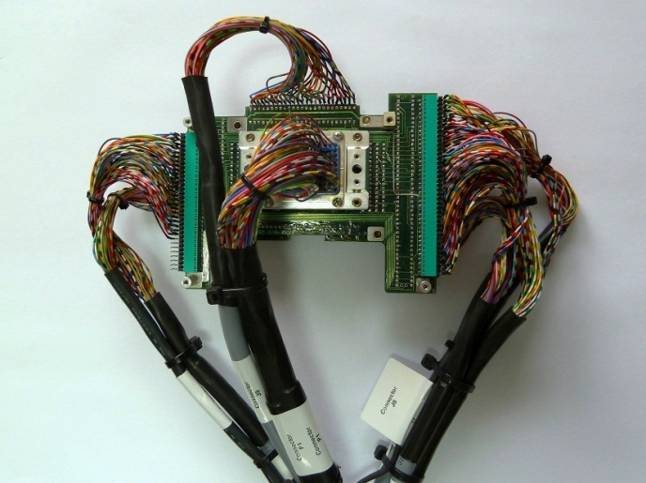
Challenges in testing for intermittency
Typical functional tests have a one-circuit at a time mentality –the fault must occur within that test window- Testing Blind Spot
This is compounded by digital averaging of test results which can lead to the intermittent signs in the signal being lost
Time consuming – how long do you spend with the test equipment connected to any one connection?
Inadequate test coverage combined with the inability to replicate environmental stimuli and time pressures → NO FAULT FOUND
What can the Through-Life studio potentially do differently?
In talks with Copernicus Technologies about incorporating their advanced state-of-the art testing equipment into the studio
Ability to test all connections simultaneously with the board/unit in an operational state, detecting nanosecond duration faults

Slide 14
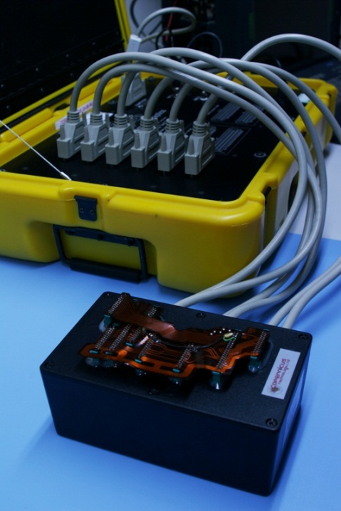
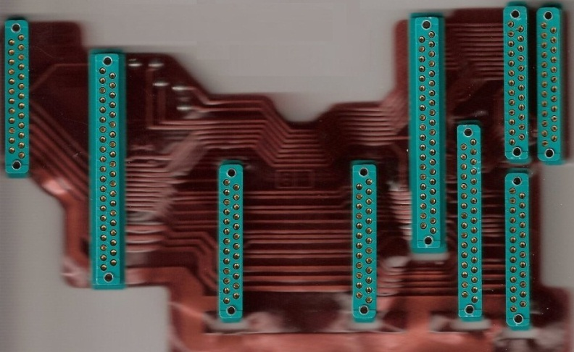
Example of the Studios Potential Testing Capabilities (Copernicus Technologies Ltd)
Ribbon Cable from a helicopter radio
Suffered from repeated removals due to intermittent interference
Standard ATE one-circuit at a time testing failed to locate the source of the intermittent fault
Complicated by the large number of connections and maintenance pressures on time
Testing all circuits at once using equipment based on Analogue Neural Networks the source was located in seconds
Intermittent problems in multiple connectors
(Copernicus Technologies Ltd)

Slide 15
The Centre’s Testing Capabilities
Often the symptoms observed during operation cannot be replicated in the maintenance process
The chambers capabilities will provide ability to replicate operating conditions to reproduce the fault symptoms observed during operation
Many ATE only test for the functionality of a unit i.e. is it serviceable?
The centres capabilities will provide additional integrity testing
$$Functional Test+Integrity Test= Increased Availability$$
Provide testing facilities and capabilities not available as standard ATE
Identify and localise the root cause of the problem
Quantify the problem make design/operating recommendations
Provide advanced technical solutions (HUMS)

Slide 16

Phase 3: Multi-Disciplinary Modelling for Design Goals
Work towards standardisation of NFF terminology, intermittency testing
Establish cross-discipline features and design solutions which can be applied to engineering design
Develop design rules and a manufacturing handbook for avoidance of the root causes of NFF in system design
Develop a system design evaluation standard that will aid in reducing the problem of NFF occurring later in the life cycle
NFF Handbook
Notes:
And in Phase 3 establish multi-disciplinary design goals and guidance

Slide 17
Summary - Objectives in NFF Research
To identify procedural, process and behavioural issues that need to be changed, learning from best practice in each industry.
To devise strategies, methodologies and system design rules to mitigate the intermittent NFF failure mechanisms and to demonstrate their effectiveness in reducing the likelihood of NFF occurrences.
To develop a multi-disciplinary approach at the system level for the effective analysis of the root causes of NFF in order to assist design activities
To develop a handbook and a system design evaluation standard with procedures that will reduce the problem of NFF.
Aim to encourage other industry partners to join and use the centres capabilities to address other NFF issues not currently under investigation
Notes:
Here the overall Centre objectives

